Slide 1
Welcome
Legal Framework of Good Governance in
Cooperative Sector, Maharashtra
Pralhad Kachare
Retired Additional Collector (Selection Grade)

Slide 2
Legal Framework for Good Governance in Maharashtra
Information Rights
  Right to Information Act 2005
  Maharashtra Right to Information Rules 2005 (Amended in 2012)
Delay Prevention
  Maharashtra Prevention of Delay in Discharge of Duty Act 2005
  Maharashtra Prevention of Delay in Discharge of Duty Rules 2013
Record Management
  The Maharashtra Public Records Act 2005
  Maharashtra Public Records Rules 2007
Public Service Rights
  The Maharashtra Right to Service Act 2015
  The Maharashtra Right to Service Rules 2016
Notes:
RECORD MANAGEMENT → Maharashtra Public Records Act 2005 → Maharashtra Public Records Rules 2007

Slide 3



Slide 4
National Historical Perspective
Citizen’s Fundamental Right to access public information
Article 19(1)(a) of Constitution
Supreme Court Decisions
Struggle by Media
Struggle by Civil Society -- Rajasthan
First Task Force…..1996
FOI Act
State Acts
RTI Act 2005

Slide 5
The Beginning…
WE, THE PEOPLE OF INDIA, having
solemnly resolved…
…to secure to all its citizens LIBERTY of thought, expression…
…adopt, enact and give to ourselves this Constitution
– Preamble to the Constitution of India

Slide 6
Informed
Citizenry
Practical
Mechanism
Transparency
Objectives
To contain
corruption
Accountability

Slide 7
Basic Tenets
Disclosure a rule and Secrecy an exception
Transparency means public interest
Public Interest overrides
It is a part of Global Process.
Governance will improve

Slide 8
PARADIGM SHIFT
An act which is being implemented
by the people
and acted upon
by the government

Slide 9
Important shift
RTI Act is a complete code in itself
Disclosure is a Rule and Denial is an exception
Citizen to implement and Govt. Instrumentality to obey.
To deny any information - Restrictions, conditions and prerequisites imposed and prescribed by law should be satisfied.

Slide 10
Chapter 1 Preliminary
Section
1. ‍ Short title, extent and commencement
2. Definitions
3. Right to Information

Slide 11
Eco System of RTI in Maharashtra
Appropriate Government
Competent Authorities
M
E
D
I
A
N
G
O
s
Public Authorities
PIO , APIO
PIO , APIO
FAA
FAA
State Information Commission

Slide 12
State Information Commission
SIC Konkan Division
SIC Brihan Mumbai
SIC Nashik Division
State Chief Information Commissioner
Mumbai
SIC
Pune Division
SIC
Amravati Division
SIC
Nagpur Division
SIC Aurangabad Division

Slide 13
Section 1: Short title, extent and commencement
(1) | This Act may be called the Right to Information Act 2005
(2) | It extends to the whole of India
(3) | The provisions of sub-section (1) of section 4, sub-sections (1) and (2) of section 5, sections 12, 13, 15,16, 24, 27 and 28 shall come into force at once, (i.e. from 15th June 2005)
 | and the remaining provisions of this Act shall come into force on the one hundred and twentieth day of its enactment. (i.e. 12th October 2005)

Slide 14
Section 2 : Definitions i.e. Important Concepts
Appropriate Government
Competent Authority
A
C
C
O
U
N
T
A
B
L
I
T
Y
T
R
A
N
P
E
R
A
N
C
Y
Third Party
Public Authority
RTI Act based on 1. Transparency, 2. Accountability & 3. Containing Corruption
Right to Information
Information
IC
FAA
CPIO
CAPIO
Record
Containing Corruption

Slide 15
Section 2(j) : Right to Information
Section 2(j) | “right to information” means the right to information accessible under this Act which is held by or under the control of any public authority and includes the right to
 | (i) | inspection of work, documents, records;
 | (ii) | taking notes, extracts, or certified copies of documents or records;
 | (iii) | taking certified samples of material;
 | (iv) | obtaining information in the form of diskettes, floppies, tapes, video cassettes or in any other electronic mode or through printouts where such information is stored in a computer or in any other device;

Slide 16
Third party
2 (n) "third party" means a person other than the citizen making a request for information and includes a public authority.
First Party
Requester of information
Second Party
Requester of information
Third Party
Individual, NGO, Company, another Govt, Public Authority

Slide 17
Section 2(h): Public Authority
Body, Institution or Authority
Established or constituted by
Act of Parliament or State Legislature
Order or notification of appropriate Govt.
Constitution of india
And also includes
Body owned controlled or substantially financed by appropriate Govt.
NGO substantially financed from funds provided by appropriate Govt.

Slide 18
Is a Co-operative Society – Public Authority under RTI Act ?
Does RTI Act apply to cooperative societies ?

Slide 19
SCI - Thalappalam Service Cooperative Bank Ltd. & Ors. v. State of Kerala & Ors
The Supreme Court finally held that co-operative societies are not public authorities within the meaning of the RTI Act.

Slide 20
Section 2(f): “Information"
"information“
means any material in any form, including records, documents, memos, emails, opinions, advices, press releases, circulars, orders, logbooks, contracts, reports, papers, samples, models, data material held in any electronic form and
It includes information relating to any private body which can be accessed by a public authority under any other law for the time being
in force;

Slide 21
BHC Aurangabad Bench
Jalgoan Jilha Urban Co-Op Banks ... vs The State Of Maharashtra And Ors on 13 February, 2017
The provisions of the Maharashtra Cooperative Societies Act if read with the definition definition of information given in section 2(f) of the Act, it can be said that everything which is mentioned in the definition of information needs to be supplied by the cooperative institution to the authority created under the Cooperative Societies Act.

Slide 22

Key Information Rights of Members
Right to Inspect Documents:
Members have the right to inspect books, registers, and documents of the society free of charge.
Right to Obtain Copies:
Members can obtain copies of these documents upon payment of a prescribed fee, as per Section 32(2) & section 154B(8)(2),
This is stipulated in Section 32(1) of the Act & section 154B(8)(1), which ensures transparency in the operations of the cooperative society.
This right allows members to access important information about the society's functioning and financial status.

Slide 23
Key Information Rights of Members
Right to Access to Financial Reports:
Members are entitled to receive copies of the society's approved bye-laws and audit reports, which provide insights into the financial health and governance practices of the society

Slide 24
How the right to information of members is operationalized
A member can get information of cooperative society
From MC under section 32 or 154B(8) / Rule 27 & 38/ Bye Law provision
Through Annual Reports, AGMs, & Minutes of Meetings
Through Registrars under RTI Act
RTI application to society is not proper way to get informaion

Slide 25
Section 154B(8) of the Maharashtra Cooperative Societies Act, 1960
Right to inspect documents
154B-8. (1) Every Member of a society shall be entitled to inspect, free of cost, at the society’s office during office hours, or any time fixed for the purpose by the society,
  a copy of the Act, the rule and the bye-laws,
  the last audited annual balance sheet,
  the profit and loss account,
  a list of the members of the Committee,
  a register of members,
  the minutes of general meetings,
  minutes of Committee meetings and
  those portions of the books and records in which his transactions with the society have been recorded.

Slide 26
Section 154B(8) of the Maharashtra Cooperative Societies Act, 1960
Right to inspect documents
154B-8. (2) A society shall furnish to a Member,
on request in writing and on payment of such fees at such rate as may be decided by the Registrar, from time to time,
  the copies of any documents mentioned in the foregoing subsection within forty-five days from the date of payment of such fees and
  when the Society is assisted by the Government in the form of share capital, loan and land, the said Society shall furnish such information within thirty days from the date so requested by a member.

Slide 27

Section 83 : Inquiry by Registrar
Registrar can conduct inquiries into the constitution, working, and financial conditions of a cooperative society.
1
During such inquiries, members and past members are obligated to furnish information and produce relevant documents in their possession.
2
This implies that members have access to information related to the society's affairs within the scope of such inquiries.
3

Slide 28
The President, Z.B.70, Madhanam Primary Agricultural, Co-op Credit Society vs. SIC Chennai, Jt. Registrar Co-op, DDR, Mr. K. Jeeva.
The Madras High Court ruled that cooperative societies are not subject to the RTI Act. The court set aside a Tamil Nadu Information Commission order that had directed a cooperative society to disclose loan details.
Justice V. Bhavani Subbaroyan stated that cooperative societies do not qualify as ‘public authorities’ under Section 2(h) of the RTI Act. The court’s decision aligns with previous rulings, including a 2013 Supreme Court verdict.

Slide 29

Positive Implications of the Judgement
Autonomy of Cooperative Societies: Reinforces the independence of cooperative societies by not categorizing them as public authorities under the RTI Act.
Legal Clarity:
Provides a clear legal interpretation that can
guide similar cases in the future.
Operational Efficiency: Cooperative societies can operate without the administrative burden of complying with RTI requests, potentially increasing efficiency.

Slide 30

Negative Implications
Reduced Transparency: Limits public access to information on cooperative societies, potentially reducing transparency and accountability.
Potential for Misuse: Without RTI oversight, there may be a higher risk of corruption or misuse of funds within cooperative societies.
Public Distrust: The decision might foster distrust among the public, particularly if cooperative societies are seen as non-transparent entities.

Slide 31
Rights of Members of Cooperative Society
P
A
R
T
I
C
I
P
A
T
I
O
N
Inspect Documents
Obtain
Copies
D
E
M
O
C
R
A
C
Y
Right to Transfer Share Certifiate
Access to Financial
Reports
Right to access common areas
Right to financial
entitlements
Right to Dispute
Resolution
Right to vote & participate
Right to resign
Right to Nominate

Slide 32
Records maintained by cooperative society
Sr. No. | Record maintained
1 | Member record book – I form (under rule 32 of the co-operative Law)
2 | Members List – J form (Under rule 32 of the Co-operative Law)
3 | Cash Book
4 | General Ledger
5 | Personal Ledger
6 | Property Registrar
7 | Share Registrar
8 | Sinking Fund Registrar
9 | Record of Rectification in audit faults.
10 | Investment register,

Slide 33
Records maintained by cooperative society
Sr. No. | Record maintained
1 | Nomination Register.
2 | Loan Register (In case society lends to members)
3 | Mortgage deed register (if property is mortgage)
4 | Record book of the minutes of the managing committee meeting,
5 | Recorded book of the minutes of general body meeting.
6 | Deposit register (If deposit is given for utilization of electricity, supply of water, telephone etc.)
7 | Dead stock register(furniture fans, tube lights, cupboard etc., office furniture)
8 | Allotment record book in respect of allotment of flats/ galas.
9 | Any other record/registers as may be maintained.

Slide 34
Right to Information of a member of cooperative society
  Members have free access to key documents, including:
    A copy of the Maharashtra Cooperative Societies Act, 1960 and Rules, 1961.
    The society's bye-laws.
    The last audited annual balance sheet.
    Profit and loss accounts.
    A list of the managing committee members.
    The register of members.
    Minutes of general meetings and committee meetings.
    Relevant portions of books and records documenting transactions

Slide 35
The Maharashtra Cooperative Societies Rules, 1961
Rule 27: Supply of copies of documents by societies and fees therefore
(1) A member of a society requiring a copy of any of the documents mentioned in subsection (1) of Section 32 may apply to the society for the same. Every such application shall be accompanied by a deposit of such amount as may be decided by the committee for recovering the cost of preparing the copies according to the following scale, namely :-
[up to A4 Size paper-per page Rs. 2, larger than A4
Size paper-per page Rs. 3.]

Slide 36
The Maharashtra Cooperative Societies Rules, 1961
Rule 27: Supply of copies of documents by societies and fees therefore
(2): Where the copies are prepared, the amount due from the member according to the scale laid down in sub-rule (1) shall be retained by the society as copying fees and the surplus amount, if any, remaining out of the deposit shall be refunded to the member at the time of supplying copies. Where the amount deposited by the member is found to be insufficient to cover the copying fees, the member shall be called upon to pay the deficit before taking delivery of the copies.
27(3) : The copies shall be certified and signed as true copies by
any person duly authorized in this behalf by the committee or
under the bye-laws of the society

Slide 37
30. Inspection of documents in the Registrar's office by members of societies and the scale of fees for supply of copies of documents
 | Document | Fees
(i) | Application for registration of society, | Up to A 4 Size paper per page Rs. 2, Larger than A4 Size paper per page Rs.3
(ii) | Certificate of registration, | -do-
(iii) | Bye-laws of societies, | -do-
(iv) | Amendment of bye-laws of a society, | -do-
(v) | Order of cancellation of the registration of a society, if any, | -do-
(vi) | Audit report of a society, | -do-
(vii) | Annual balance sheet, | -do-
(viii) | Order under section 88, | -do-
(ix) | Order of suspension or supersession of a committee or removal of any member thereof, if any, | -do-
(x) | Any other order against which an appeal or revision is provided. | -do-]

Slide 38
Kerala HC : The Muppathadam Co-operative Bank Ltd vs. SCI, Jt. Registrar, PIO & P. R. Ramchandran
WP(C) NO. 30694 OF 2024 Dated 29th NOV. 2024
Member P. R. Ramchandran sought information in respect of an agreement entered into between the Petitioner-Society and a Labour Contract Society involved in the construction business, AGM p.roceedings etc
Society did not give information to applicant member
He approached PIO of Cooperative Deptt Assistant Registrar
He said this information is not in his possession hence application rejected.
FAA Joint Registrar upheld PIO’s decision

Slide 39
Kerala HC : The Muppathadam Co-operative Bank Ltd vs. SCI, Jt. Registrar, PIO & P. R. Ramchandran
WP(C) NO. 30694 OF 2024 Dated 29th NOV. 2024
Second appeal was filed
SIC also rejected the second appeal
The member P.R. Ramchandran filed one W.P.(C)
No.37938/2023 stating that Petitioner bank is not a
public authority hence RTI not applicable & not under
the control of Cooperative Registrar
This was carried in appeal before Division Bench in W.A. No.729/2024 wherein case was remanded back to SIC for reconsidering appeal.

Slide 40
Kerala HC : The Muppathadam Co-operative Bank Ltd vs. SCI, Jt. Registrar, PIO & P. R. Ramchandran
WP(C) NO. 30694 OF 2024 Dated 29th NOV. 2024
SIC directed Joint Registrar to access and provide documents sought to the applicant.
This was appealed by the society which happens to be a bank in this WP.
The Hon. Court directed
“ It cannot be disputed that the Registrar has the power to gather information from the Petitioner-Society over which he has supervisory control under the Co-operative Societies Act” :

Slide 41
Kerala HC : The Muppathadam Co-operative Bank Ltd vs. SCI, Jt. Registrar, PIO & P. R. Ramchandran
WP(C) NO. 30694 OF 2024 Dated 29th NOV. 2024
The Hon. Court concluded that:
“it can certainly be held that the information sought by the applicant is accessible by the Registrar of the Co-operative Societies and the information desired by the applicant is not barred under Section 8 of the Right to Information Act. ” Hence the petition was dismissed and SIC order was confirmed.

Slide 42
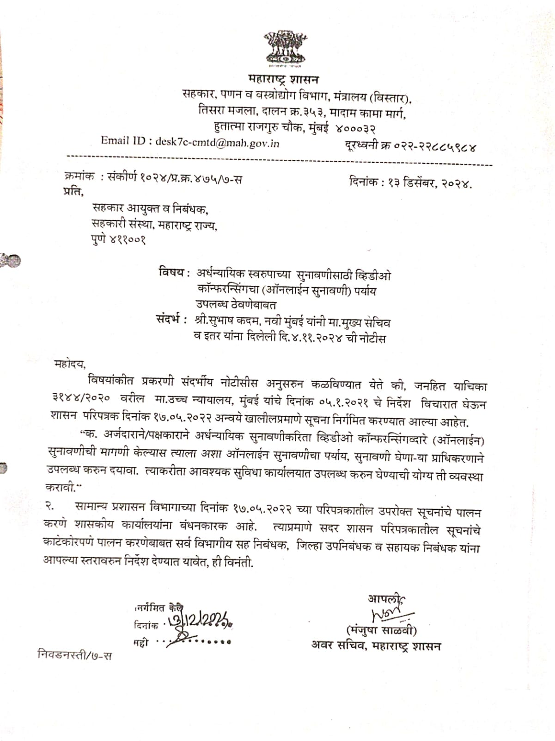

Slide 43
Chapter 2
Chapter 2 : Obligations of Public Authorities
3. Right to Information
4. Every Public Authority
5. Designation of Public Information Officers.
6. Request for obtaining information.
7. Disposal of request.

Slide 44
Chapter – 2
3. Right to Information and obligations of public authorities
Subject to the provisions of this Act, all
citizens shall have the right to information.

Slide 45
DoPT Guidelines as to obligations of Public Authority
Suo Motu Disclosure i.e. Proactive Disclosure
Dissemination of Information
Publication of Facts about Policies and Decisions
Timely providing information
Right to Information vis-à-vis other Acts
Maintenance and Computerization of information and records

Slide 46
DoPT Guidelines as to obligations of Public Authority
Information held by and under the control of Public Authority
Providing Information ---- Right to Information of Citizens
Three types of information --- Proactive – On application ---Exempted
Information Exempted From Disclosure

Slide 47
Types of Information in RTI Act
Sec.4 | Information to be disclosed proactively by Public Authority
Sec.6 & 7 | Information to be provided on application and on payment of fees
Sec.8 & 9 | Exempted Information for which there is no legal obligation to provide it.

Slide 48
Sec.4 | Information to be disclosed proactively by Public Authority

Slide 49
Proactive Disclosure
Section 4(1)(b) : Every public authority shall publish within one hundred and twenty days from the enactment of this Act-
Particulars of organization/ functions and duties
Powers and duties of officers / employees
Procedure followed for decision making
Norms set for discharge of functions …

Slide 50
Proactive Disclosure
Contd..
v) Rules/regulations/instructions/manuals/ records held
vi) Categories of documents held by it
vii) Arrangements for citizen consultations
viii) Details of boards, Councils, Committees, etc…

Slide 51
Proactive Disclosure
Contd..
Directory of officers and employees
Monthly remuneration received by officers and employees
Budget, Plan and expenditure details
Manner of execution of subsidy programs
Concession details

Slide 52
Pro-active Disclosure
Contd..
xiv. Details of material in electronic form held by the office
xv. Facilities available to citizens for accessing information
Xvi. Details of PIO s
xvii. Such other information as prescribed.
And update these publications every year

Slide 53
Proactive Disclosure
Ongoing commitment – Activity
Template
Large amount of information has to be in public domain
Covers new information- constant updating

Slide 54
Sec.4 | Role of Public Information Officer Process of Disposal of RTI Applications

Slide 55
Section 7: Short title, extent and commencement
(1) | Provide or reject information within 30 days , fee, no fee BPL Information of life and liberty to be provided within 48 hours
(2) | No information or no denial within 30 days--- Deemed Refusal
(3) | Intimation of fees, review, to be communicated by PIO
(4) | PIO to assist applicant
(5) | Applicant to pay fees as may be prescribed unless BPL
(6) | Information not provided in 30 days / to be provided free of cost if directed to be provided in appeal

Slide 56
Rule 3 : Fee for information
Rule | Under Section | Particulars of Fees and Costs | Details of Fee or Cost Rs. | Mode of Payment
1 | 6(1) | Application Fee | Rs. 10 | cash against proper receipt or demand draft or by bankers cheque payable to the concerned PIO.
2(a) | 7(1) | A-4 or A-3 size paper-- created or copied | Rs. 2 per page
2(b) | 7(1) | Larger size paper | Actual charge or cost price of a copy | cash against proper receipt or demand draft or by bankers cheque payable to the concerned PIO. No Fee or cost for applicant under BPL u/s 7(5) proviso
2(c) | 7(1) | Samples or models | Actual cost or price
2(d) | 7(1) | Inspection of records, | No fee for the first hour ; and a fee of rupees five for each subsequent hour (or fraction thereof) thereafter .
3(a) | 7(5) | Information provided in diskette or on a floppy, rupees fifty per diskette or per floppy | Rs. 50 per Floppy/CD/Diskette
3(b) | 7(5) | Information provided in printed form | Printed price of publication or rupees two per page

Slide 57
Section 7: Short title, extent and commencement
(7) | PIO to consider representation of third party u/s 11 before taking decision.
(8) | In case of refusal PIO shall communicate in writing the reasons for such rejection; the period within which an appeal against such rejection may be preferred; and the particulars of the appellate authority.
(9) | An information shall ordinarily be provided in the form in which it is sought unless it would disproportionately divert the resources of the public authority or would be detrimental to the safety or preservation of the record in question.

Slide 58
Sec.8 & 9 | Exemptions

Slide 59
Section 8: . Exemption from disclosure of information.
(1)
(2) | a public authority may allow access to information, if public interest in disclosure outweighs the harm to the protected interests.
(3) | Subject to the provisions of clauses (a), (c) and (i) of sub-section (1), any information relating to any occurrence, event or matter which has taken place, occurred or happened twenty years before the date on which any request is made under section 6 shall be provided to any person making a request under that section:
a) National Security | f) Foreign Government
b) Contempt of Court | g) Safety of Informer in law Enforcement
c) Parliamentary Privilege | h) Investigation
d) Trade Secrecy | i) Cabinet Papers
e) Fiduciary Relationship | j) Privacy

Slide 60
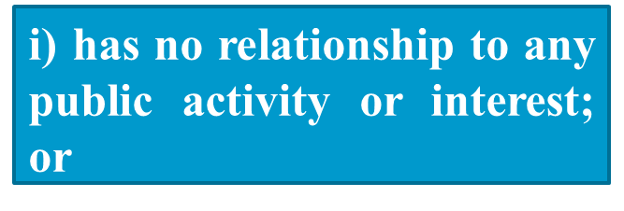
Section 8(1)(j)
Section 8(1)(j) excludes disclosure of personal information, the disclosure of which:-
if the PIO/AA are satisfied that larger public interest justifies disclosure.
ii) would cause unwarranted invasion of the privacy of the individual.

Slide 61

Give info if public interest outweighs
Section 8(2)
Public Interest
in disclosure
Harm likely to be
caused to the
Protected Interests
Reject info if harm to public interest outweighs

Slide 62
Section 9: . . Grounds for rejection to access in certain cases.
(1) | Without prejudice to the provisions of section 8, a Central Public Information Officer or a State Public Information Officer, as the case may be, may reject a request for information where such a request for providing access would involve an infringement of copyright subsisting in a person other than the State.

Slide 63
Chapter 2
Chapter 2 : Obligations of Public Authorities
8. Exemption from disclosure of information.
9. Copyrighted information .
10. Severability
11. Third party information.

Slide 64
Section 10: . Severability
(1) | Where request is refused but part of the information can be provided such part may be provided
(2) | Where access is granted to a part of the record under sub-section (1) PIO shall give notice to applicant informing : Part of the record after severance is provided Reasons for severance or findings Name and designation of officer taking decision Fee details Right of applicant to appeal on severance and fees

Slide 65
Flowchart
Third Party Consultation Process
PIO to decide whether information requested
relates to or has been supplied by a third party
and
has been treated as confidential by that third party
Yes
No
Follow Normal
Procedure
As laid down in section
7, 8 & 9
Follow procedure
u/s 7 (7), 11, 19 [2], 19 [3] and 19 [4]

Slide 66
Third Party Information
NOTICE to TP
“I INTEND TO DISCLOSE”
TP’s Submission
Speaking order/
NOTICE to TP
“I DECIDE TO DISCLOSE”
If NO Appeal by TP
Give Information
If Appeal by TP
Follow Appeal
Provisions
1
If PIO refuses to
disclose information
If PIO decides to
disclose information
Requester can
go in appeal
2
Wait till Appeal decision

Slide 67
Right to Information Act and Question Why
Dr. Celsa Pinto, Ex-Officio Joint ... vs The Goa State Information ... on 3 April, 2008
Equivalent citations: 2008 (110) Bom L R 1238

Slide 68
Bombay High Court,Goa Bench : Observations
The definition cannot include within its fold
answers to the question why which would be the same thing as asking the reason for a justification for a particular thing.
The Public Authorities cannot expect to communicate to the citizen the reason why a certain thing was done or not done in the sense of a justification because the citizen makes a requisition about information.
Justifications are matter within the domain of adjudicating authorities and cannot properly be classified as information.

Slide 69
Questions --- Yes
Why --- No
  Public Authorities ! Be Careful… !!!
Citizens Can not Ask Why ?
But can ask Questions ? Question means accountability

Slide 70
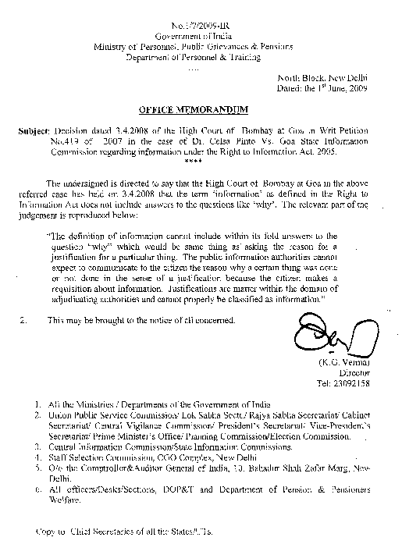

Slide 71
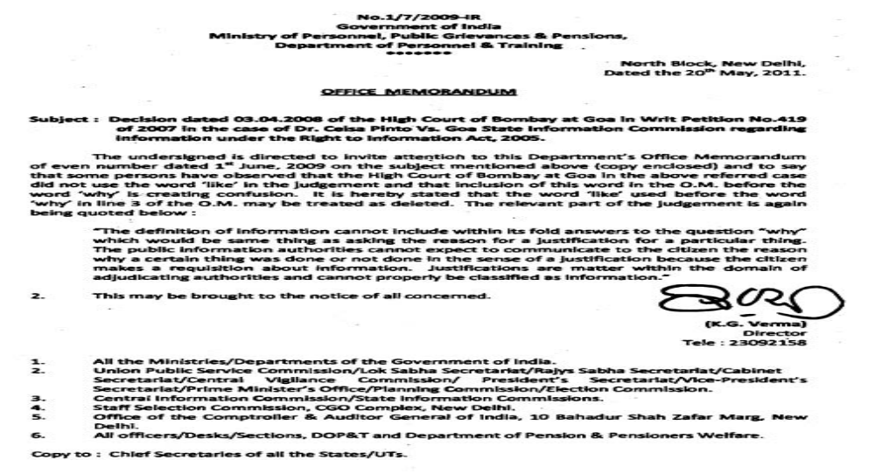

Slide 72
Citizen can ask Questions
RTI Act does not expect the PIO to provide answers which are not on record,
It does not mean that merely because the queries are prefixed with “why, what, when, whether” information can be refused.
Best possible response is to give papers which contain answers of questions of requester.

Slide 73
Section 8(1)(a)
Reserve Bank of India v. Jayantilal N. Mistry
Issue for consideration before the Supreme Court was whether all the information sought for under the Right to Information Act, 2005 can be denied by the RBI and “other Banks” to the public at large on the ground of economic interest, commercial confidence, fiduciary relationship on the one hand, and the public interest, on the other.
Rejecting all the three arguments, the Apex Court held that the RBI & other banks, as public authorities under the Act, were bound to disclose the information related to inspection reports and other documents to the applicants.
Source: Reserve Bank of India v. Jayantilal N. Mistry, AIR 2016 SC 1= (2016) 3 SCC 525.

Slide 74
Section 8(1)(a)
. Yashwant Sinha Vs. CBI Section 8(1)(a)
Section 8(2) recognises is that there cannot be absolutism even in the matter of certain values which were formerly considered to provide unquestionable foundations for the power to withhold information. Most significantly, Parliament has appreciated that it may be necessary to pit one interest against another and to compare the relative harm and then decide either to disclose or decline information.
Source : SC Review Petition (Cri) 46 of 2019 in WP (Cr) 298 of
2018, Dt 10th April 2019, K.M.Joseph J

Slide 75
Chapter 3
The Central Information Commission
Section
12. Constitution of Central Information Commission
13. Term of office and conditions of service.
14. Removal of Chief Information Commissioner or
Information Commissioner.

Slide 76
Chapter 4
The State Information commission
Section
15. Constitution of State Information Commission.
16. Term of office and conditions of service.
17. Removal of State Chief Information
Commissioner or State Information
Commissioner

Slide 77
Right to Information Act 2019
Amendment | Central Information Commission | State Information Commission
Section 13(1)(2) Section 16(1)(2) | Term - five years [for such term as may be prescribed by the Central Government] | Term - five years {for such term as may be prescribed by the Central Government]
Section 13(5)(6) Section 16(5)(6) | Status , Salary & Terms : CCIC- Chief Election Commissioner, CIC - Election Commissioner | Status, Salary & Terms SCIC - Election Commissioner …….CS SIC -- Chief Secretary of State …....ACS
 | Amendment : “ as may be prescribed by the Central Government ” | Amendment : “ as may be prescribed by the Central Government ”

Slide 78
Amendments through other Legislations
Amendment through other Acts
Amendments through other Legislations
1. The Sexual Harassment of Women at Workplace (Prevention, Prohibition and Redressal) Act, 2013. | Section 16 : Prohibition of publication or making known contents of complaint and inquiry proceedings.
The Nuclear Safety Regulatory Authority Bill, 2011 (NSRA Bill) 2011 | Prohibition of publication or making known the information
2. Digital Personal Data Protection Act 2023 | Section 44(3) : Section 8(1)(J) amended (j) information which relates to personal information

Slide 79
The rights of data subjects under the Digital Personal Data Protection Act, 2023
The rights of data subjects under the Digital Personal Data Protection Act, 2023 include:
Right to Access Information: Data subjects have the right to access information about their personal data held by data fiduciaries.
Right to Correction of Personal Data: Data subjects have the right to correct any inaccuracies in their personal data held by data fiduciaries.
Right to Grievance Redressal: Data subjects have the right to file grievances or complaints with data fiduciaries or the Data Protection Board in case of any issues related to their personal data.
Right to Nominate: Data subjects have the right to nominate individuals to act on their behalf regarding their personal data.
Right to Erasure: Data subjects have the right to request the erasure of their personal data under certain circumstances, unless retention is legally required.
Right to Consent: Data subjects must provide consent for the processing of their personal data, and consent can be withdrawn at any time.
Right to Data Protection Impact Assessments: Data subjects have the right to expect accountability measures, including data protection impact assessments, to be conducted by data fiduciaries.
These rights empower data subjects to have control over their personal data, ensure its accuracy, and seek recourse in case of any violations or grievances related to the processing of their data under the Digital Personal Data Protection Act, 2023

Slide 80
SWOT Analysis of RTI Act 2005
Strengths People’s sovereign power Largely used Act Growing Awareness Proved potentials | Opportunities To improve governance Accountability Transparency Increase democratic participation
Weaknesses Dilution by Government & Parliament – Amendments Poor performance of Ics Public Records – very poor Training & Capacity building | Threats Insecurity among applicants Amendments Working of ICs

Slide 81
Chapter 5
Powers and functions of the Information Commissions, appeal and penalties
Section
18. Powers and functions of Information
Commissions.
19. Appeal
20. Penalties

Slide 82
Chapter 6 Miscellaneous
Section
21. Protection of action taken in good faith.
22. Act to have overriding effect
23. Bar of jurisdiction of courts
24. Act not to apply to certain organisations
25. Monitoring and Reporting
26. Appropriate Government to prepare programmes
27. Power to make rules by appropriate Government
28. Power to make rules by competent authority.
29. Laying of rules.
30. Power to remove difficulties.
31. Repeal

Slide 83
Time Limits in RTI Act
Section | Provision | Time Limit
1(3) | Enforcement of RTI Act (Partial ) | From 15th June 2015
1(3) | Enforcement of RTI Act (Complete) | From 12th October 2015
4(1)(b) | Proactive Disclosure | 120 days
5(1) | Designation of PIOs | 100 days
5(2) | Transmission of application by APIO to PIO | 5 days
6(3) | Transfer of application to other Public Authority | 5 days
7(1) | Information to be provided or denied | 30 days
7(1) Proviso | Disclosure of information of life and liberty | 48 hours
11(2) | Third party consultation | 10 days

Slide 84
Time Limits in RTI Act
Section | Provision | Time Limit
11(4) | Decision as to whether or not to disclose third party information | 40 days
13(2) | Central Information Commissioner tenure | 3 years or 65 years of age whichever is earlier
16(2) | State Information Commissioner tenure | 3 years or 65 years of age whichever is earlier
19(1) | First Appeal period | 30 days ( with delay condonation)
19(6) | First Appeal disposal time limit | 30 days (In extra ordinary circumstances not exceeding 45 days )
19(3) | Second Appeal period | 90 days ( with delay condonation)
19(8) | First Appeal disposal time limit | No time limit (Reasonable Time)

Slide 85

 | Thanks

Slide 86
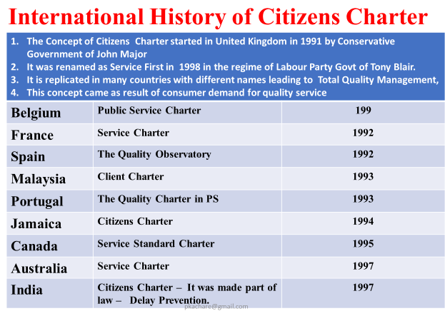
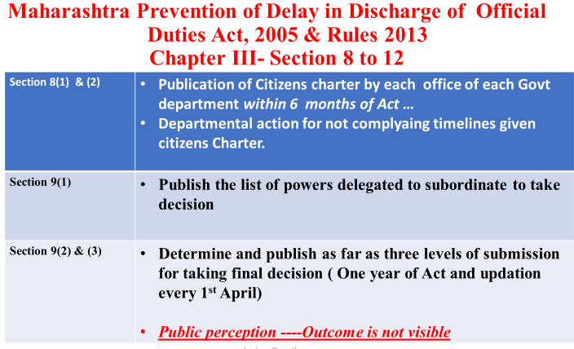
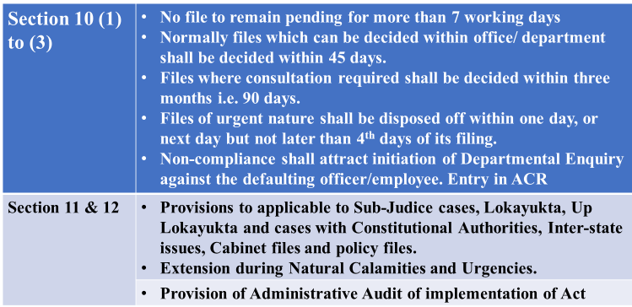
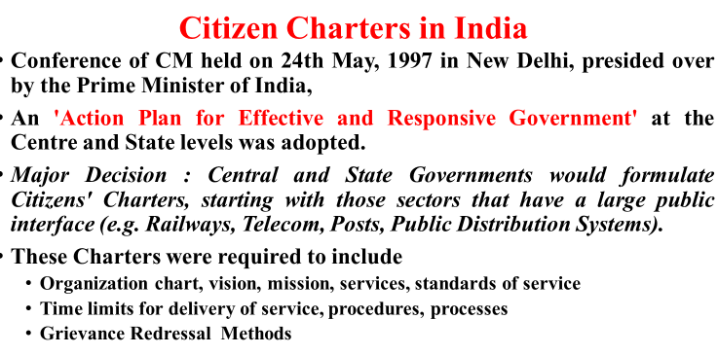

Slide 87
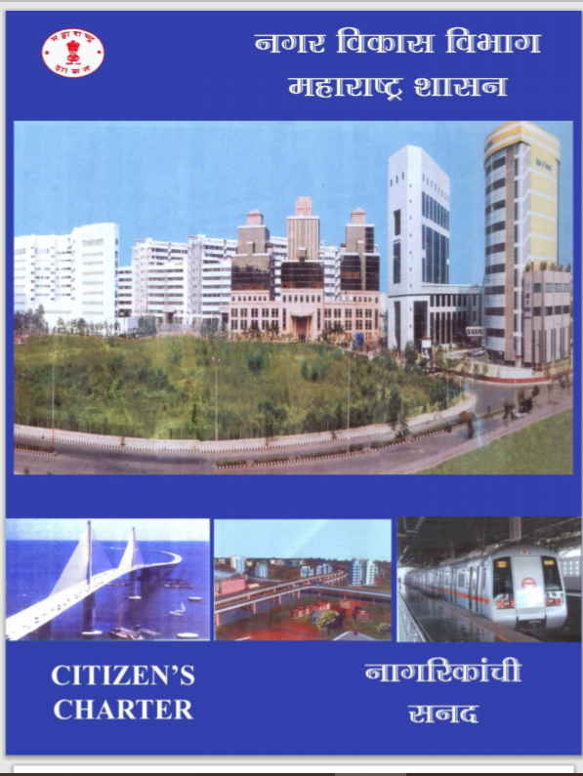
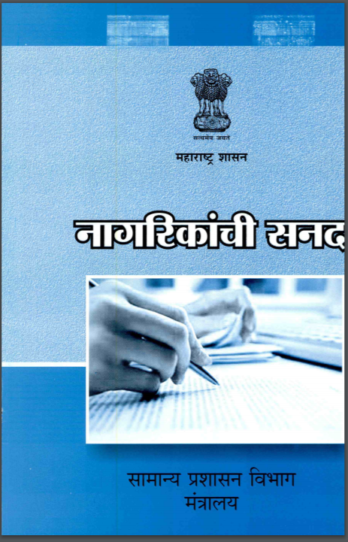


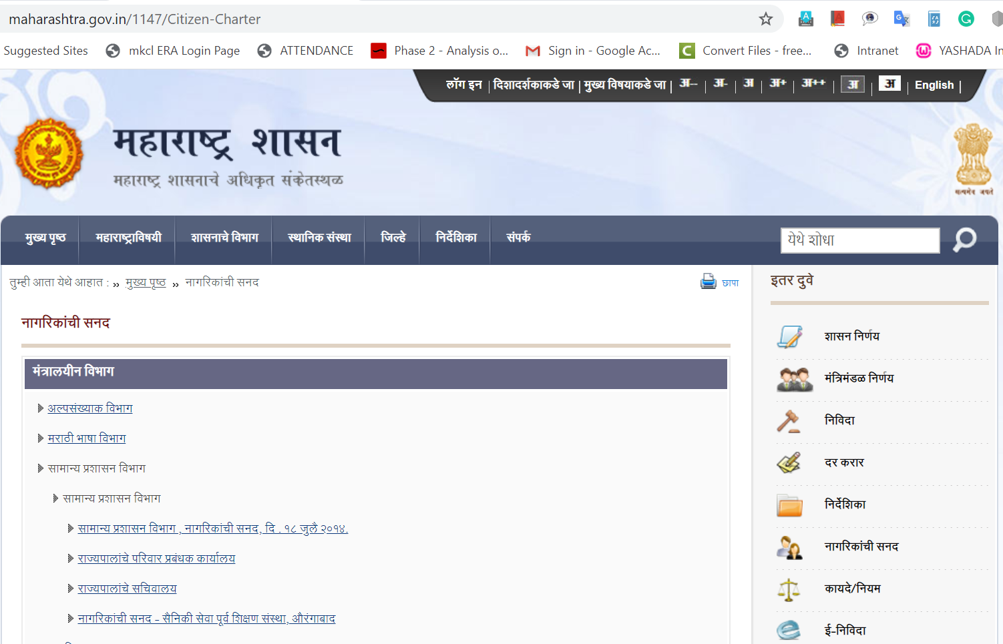
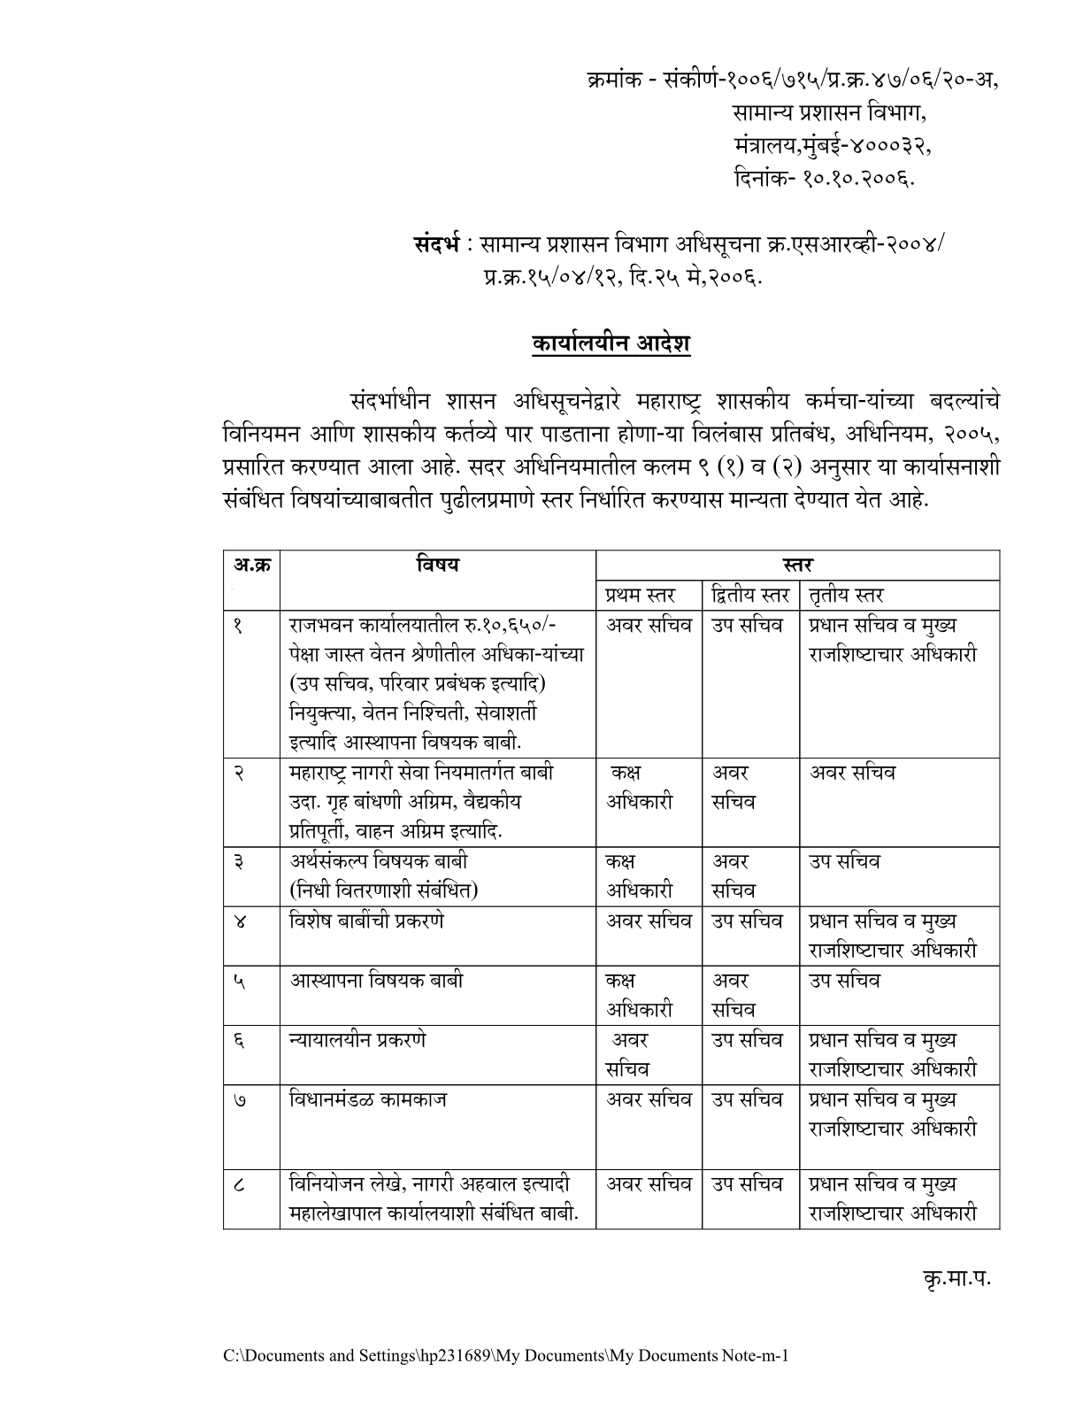
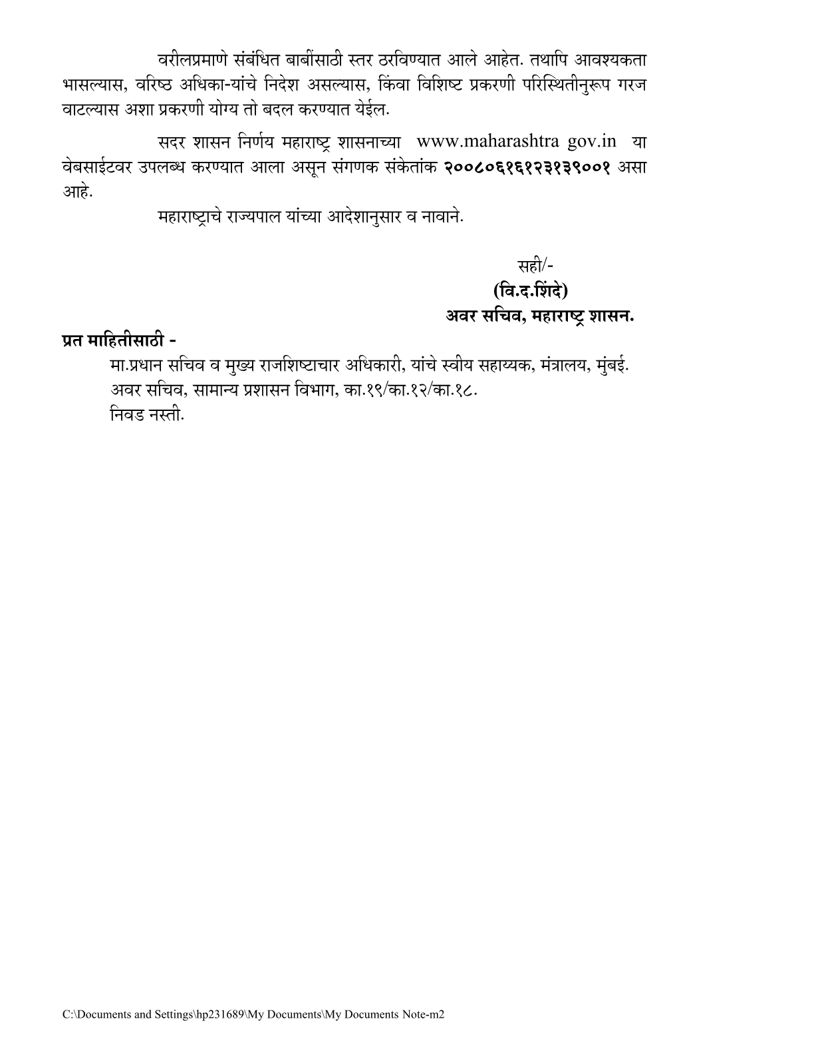

Slide 88
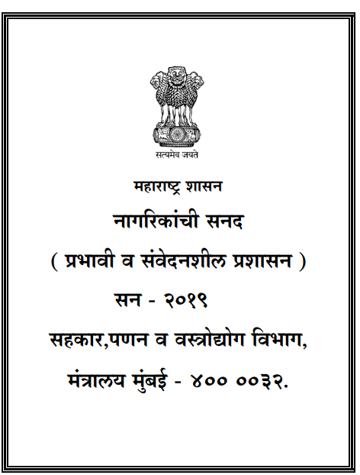
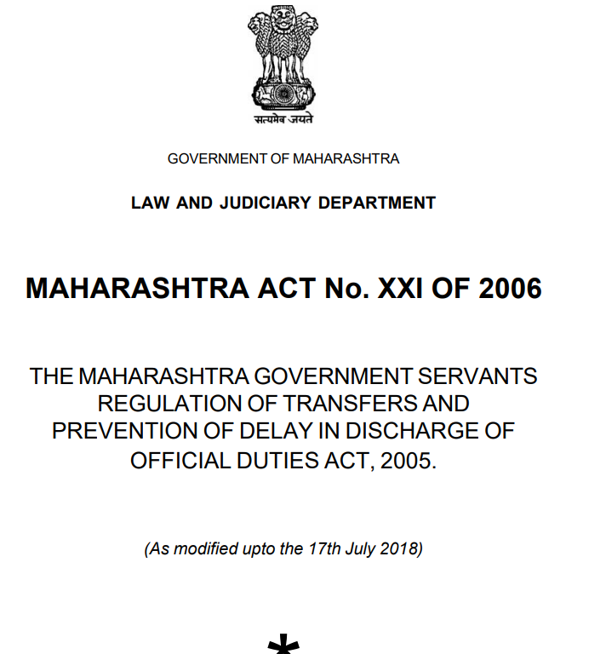

Slide 89
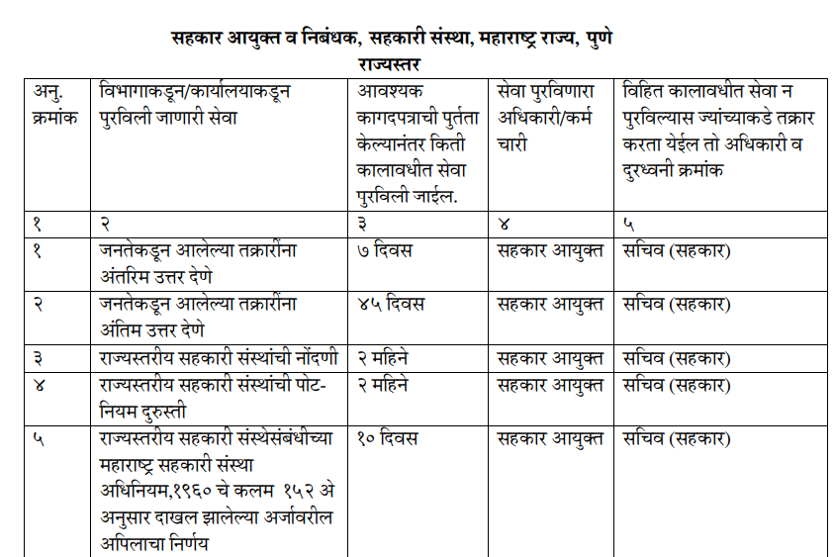

Slide 90
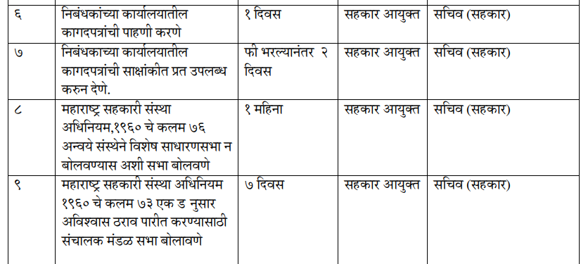

Slide 91
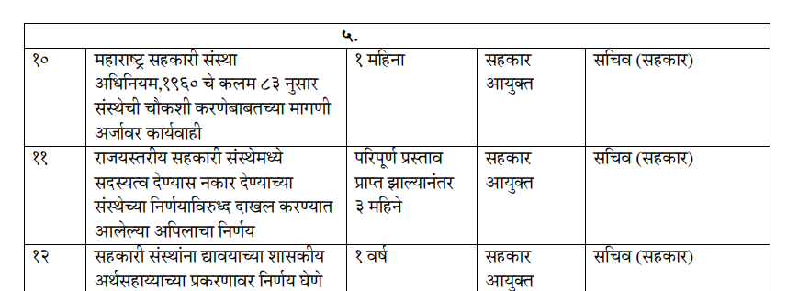

Slide 92
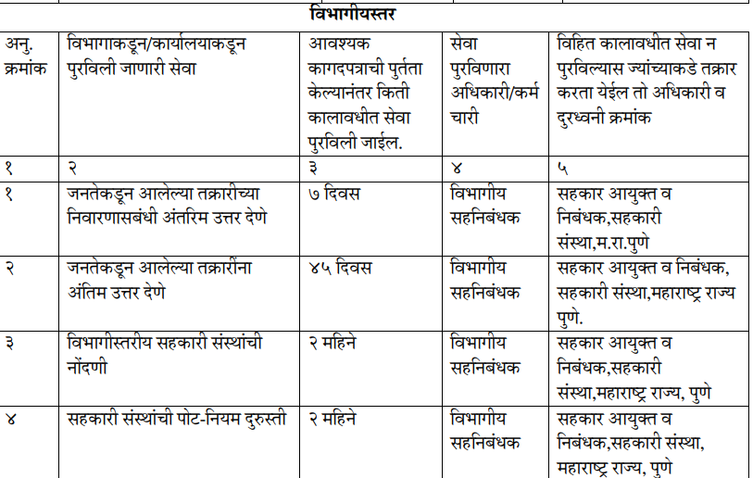

Slide 93
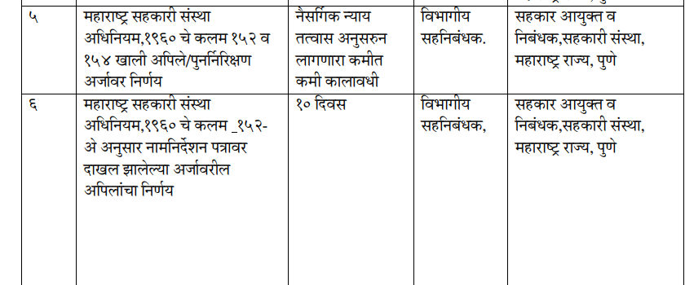

Slide 94
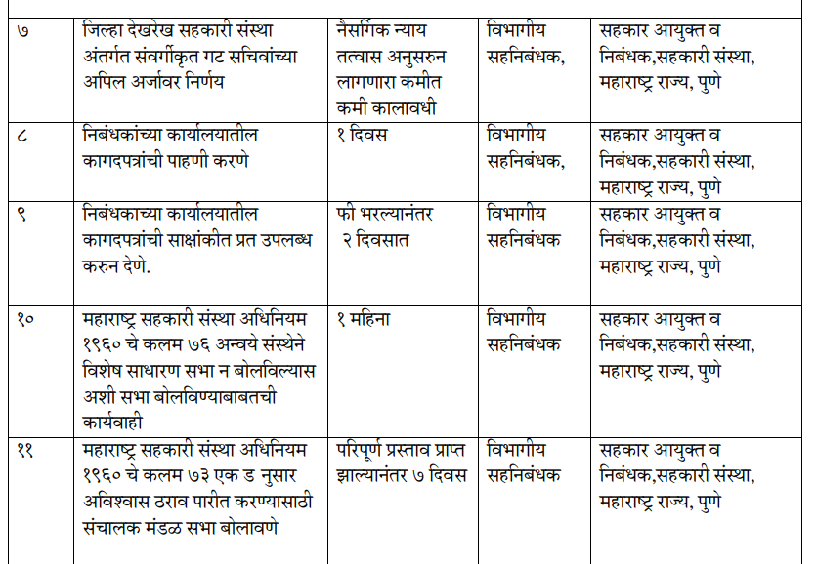

Slide 95
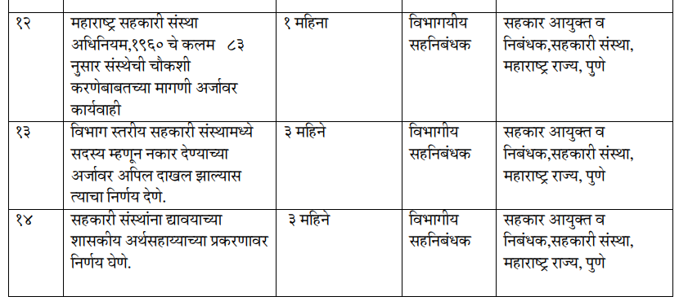

Slide 96
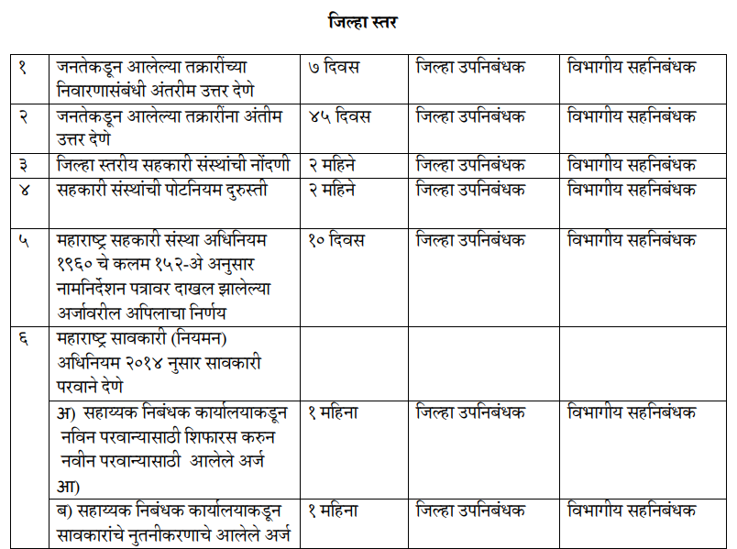

Slide 97
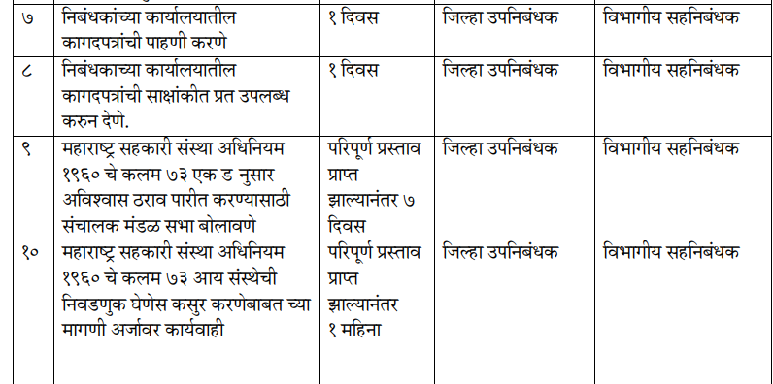

Slide 98
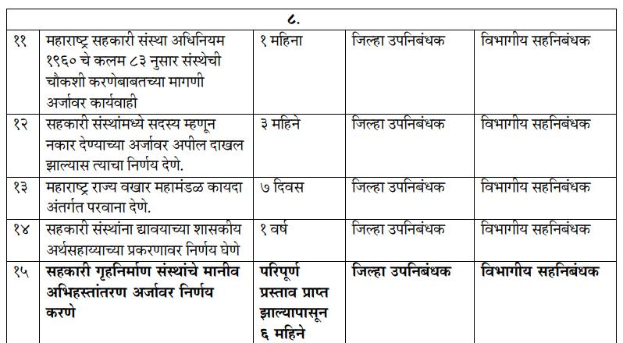

Slide 99
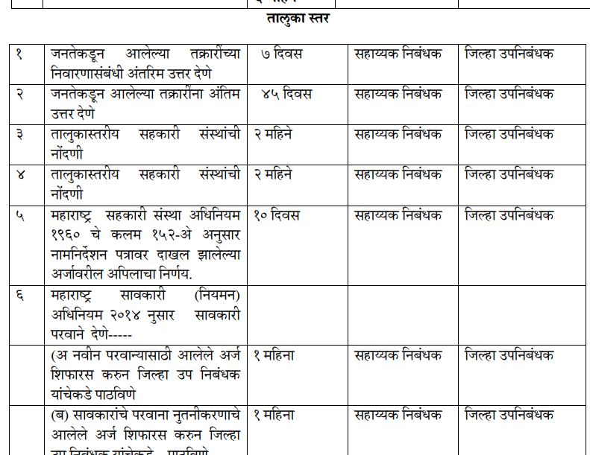

Slide 100
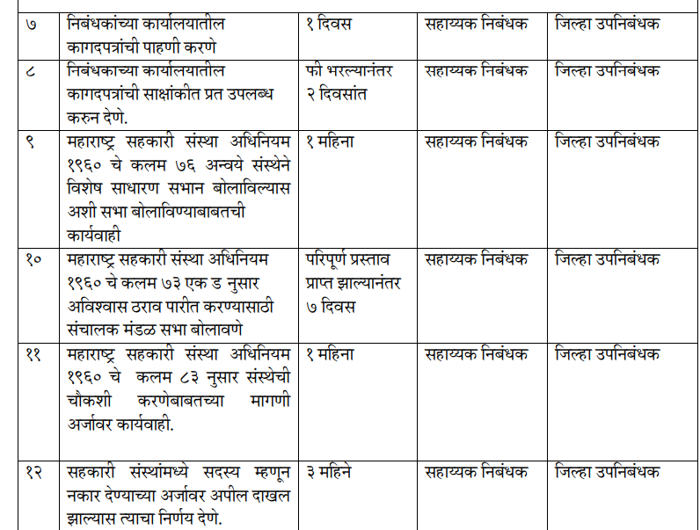

Slide 101
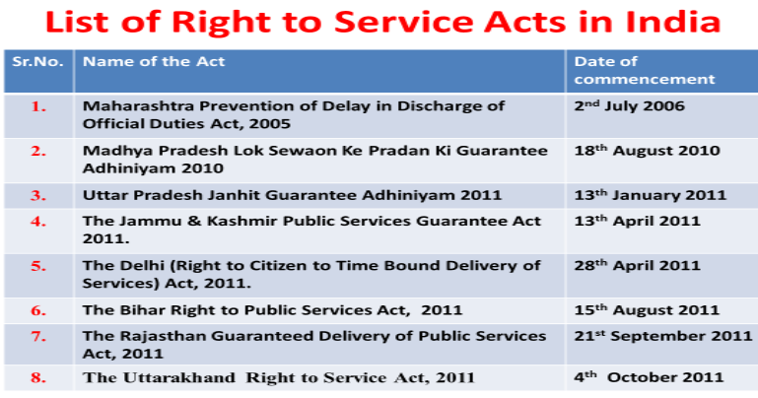
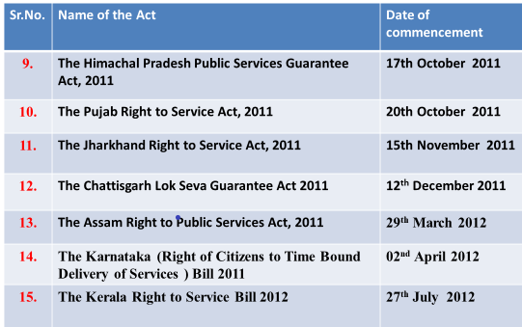
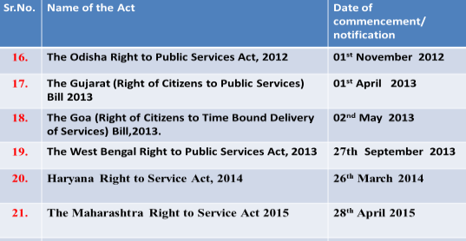

Slide 102
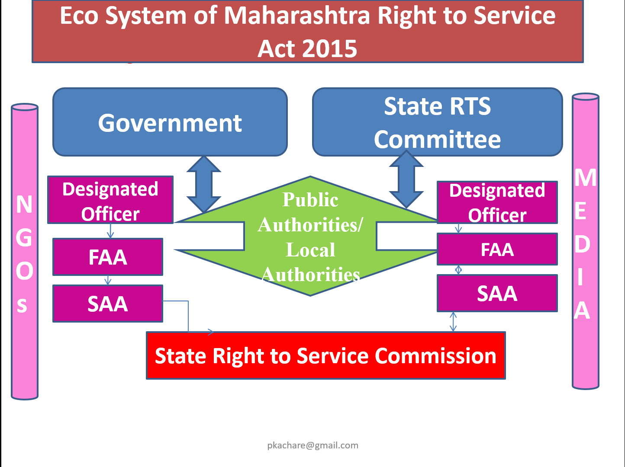
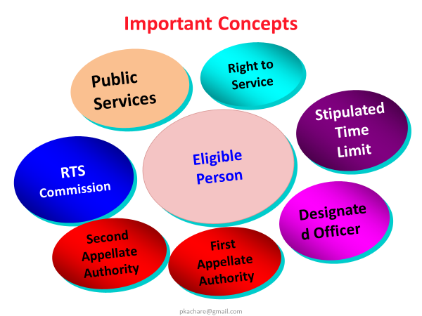

Slide 103
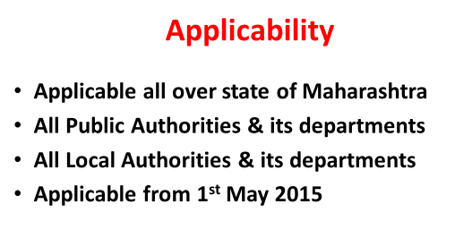
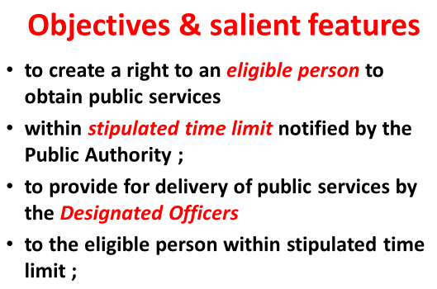
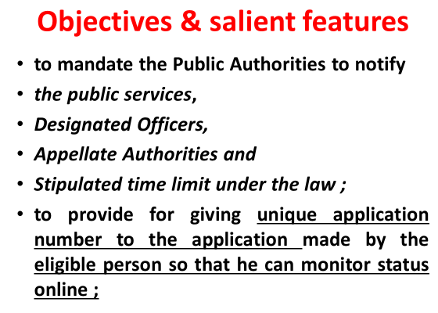
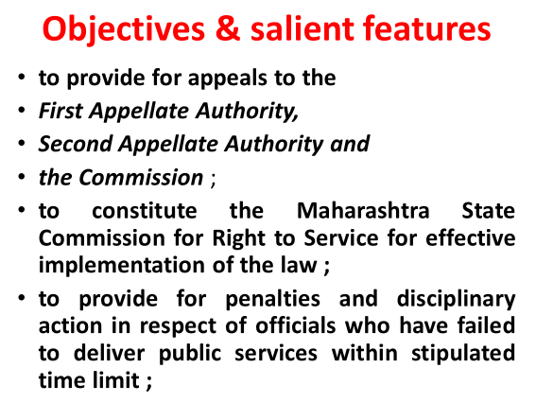

Slide 104
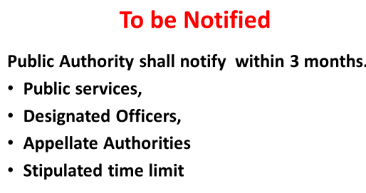
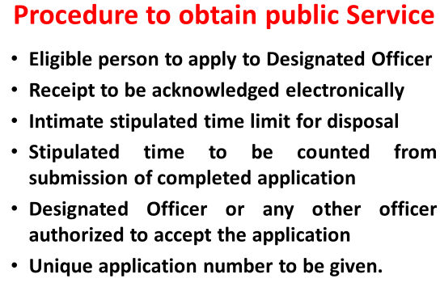
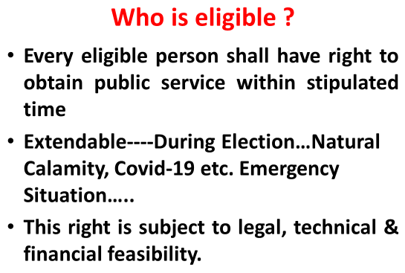
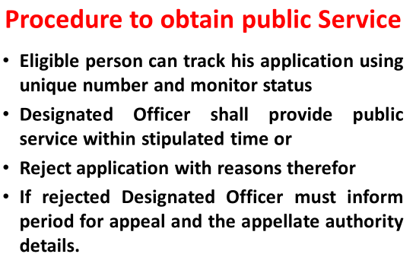

Slide 105
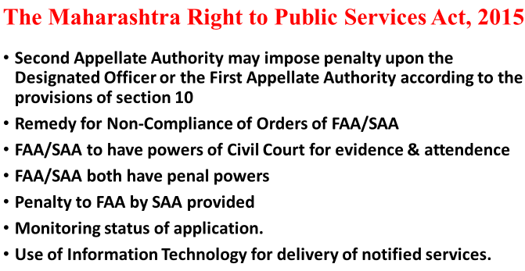
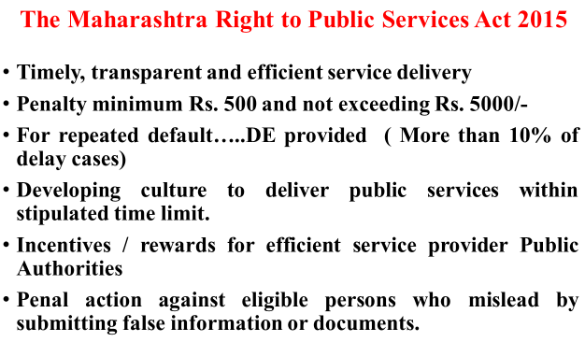
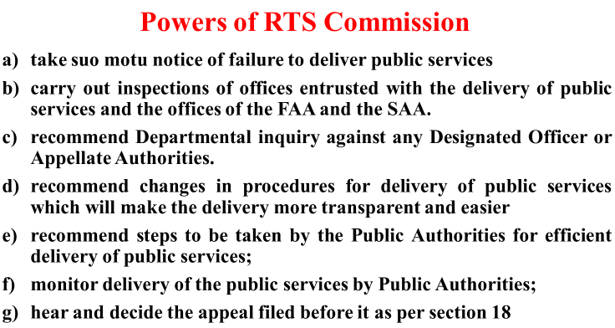

Slide 106
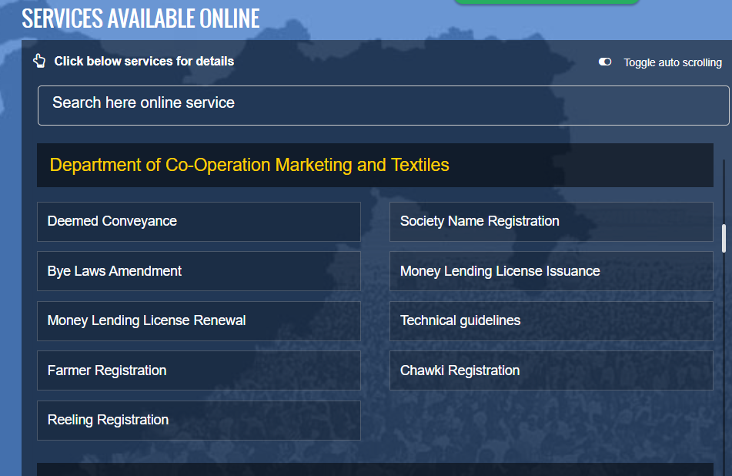

Slide 107
Life Cycle of Records
Receipt and Creation
(Stage I)
Destruction or Disposition
(Stage III)
Records Management
Use
Appraisal/ Review
Storage
Retrieval Transfer
Maintenance
(Stage II)

Slide 108
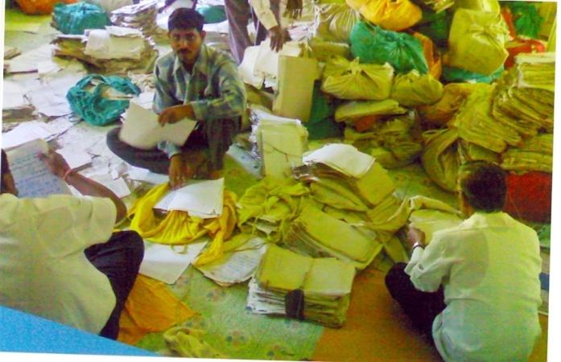
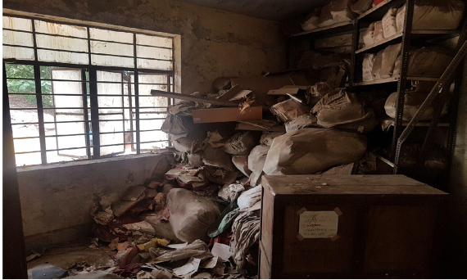
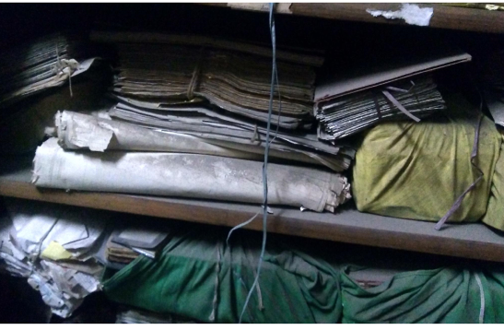
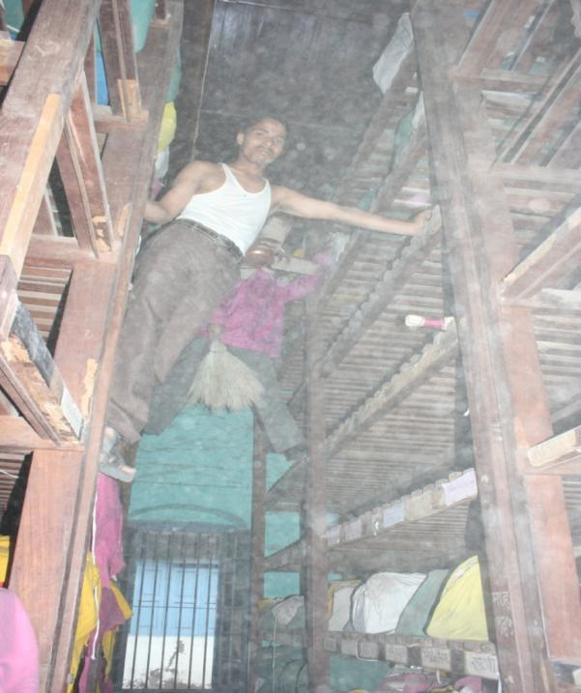
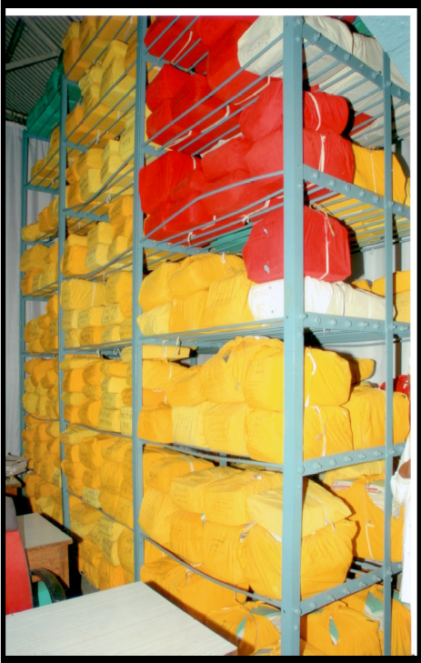
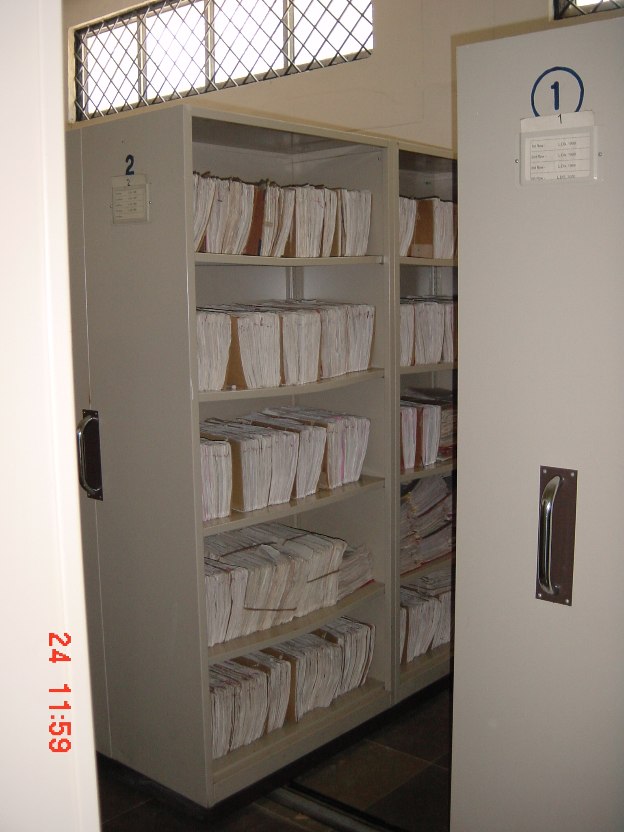




Slide 109


Slide 110
Legal Requirements
Effective Proactive Disclosure
Wide scale Dissemination
Retrieval Driven Record Management
Dedicated PIO for Updation & Records
Training & Awareness
Active partnership with all Stakeholders
Need for Uniformity
Grievance Redressal
Strengthening Information Commissions
Forward Linkages
Impact on Public Service Delivery

Slide 111
RTI requests flooding Public Authorities
Public interest Information
Lengthy information
F
R
I
V
U
L
O
U
S
V
A
X
A
T
I
O
U
S
Information Infringing Privacy
Seeking voluminous information
Unclear and vague
Information seeking justification & reasoning
Complaints & grievances redress requests
Information spanning long past years
Information Seeking remedy
Information Seeking Help
Repeated Requests for same info

Slide 112
Areas of Concern
Very poor
Record Keeping
Mindset of
Govt Machinery
Resource
crunch
Capacity
building
Volume of work
& less use of IT
Deficit of
Proactive Info

Slide 113

Thank you!

